Slide 1


WeatherForYou

Slide 2
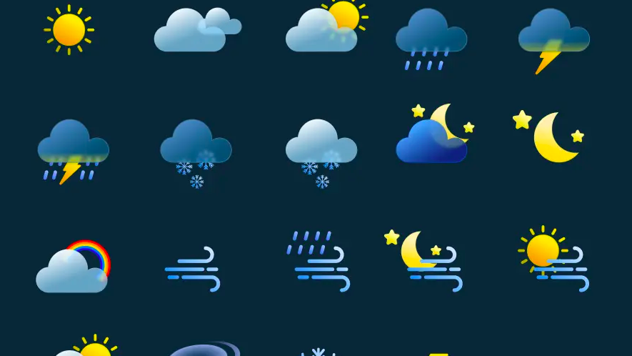
WeatherForYou

